Slide 1
FitPro project
Subtitle

Slide 2
Project flow chart
Login Page(Successful Login )
User Login
Is Admin?(yes)
Nutrition values
Create Your Own Diet Plan
Forum Discussion
Different Types Of Diets
Add/Delete Items
Logout
Log out

Slide 3
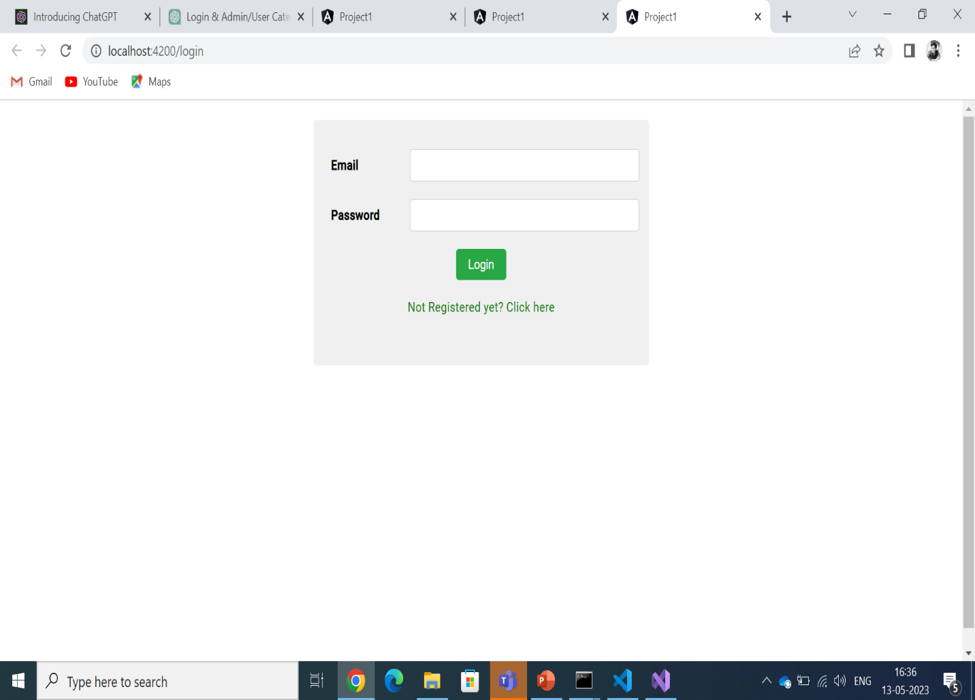
Login page
The page inputs the email and password of the user and connects to the json file.
In json file the details entered are checked and compared.
If the user is new and hasn’t registered, he/she can opt for register and enter the details.
If the user details contain user type as admin, then the admin page is logged in and if the mentioned type is as user, then the user page opens.

Slide 4
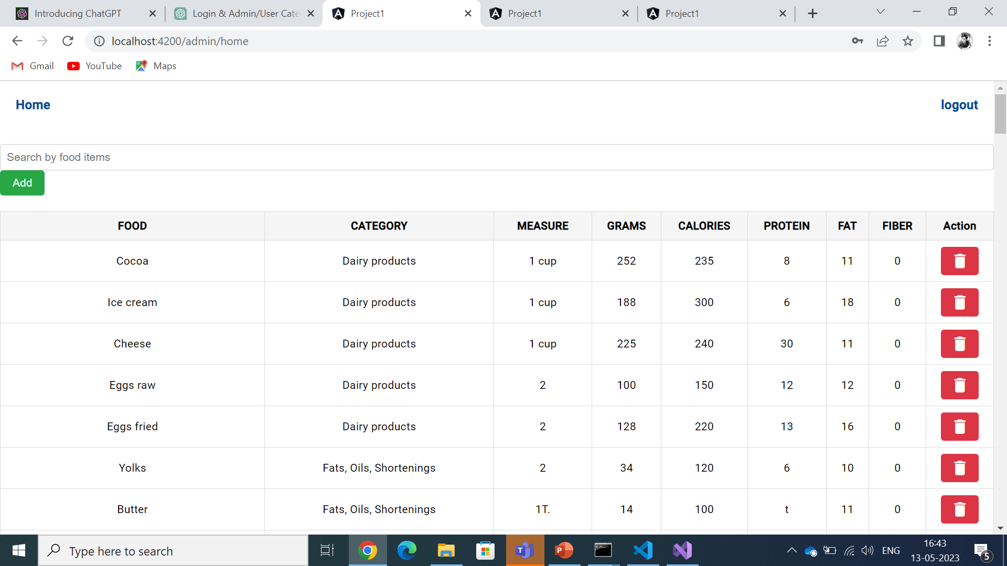
Admin side interface
The admin has a basic interface of being able to add and remove products from the list of products in the json file.
If the admin would like to delete any item from the list, he can do that, and the item will be permanently deleted from the json file as well.
The admin can search for the product as well and can delete it.

Slide 5
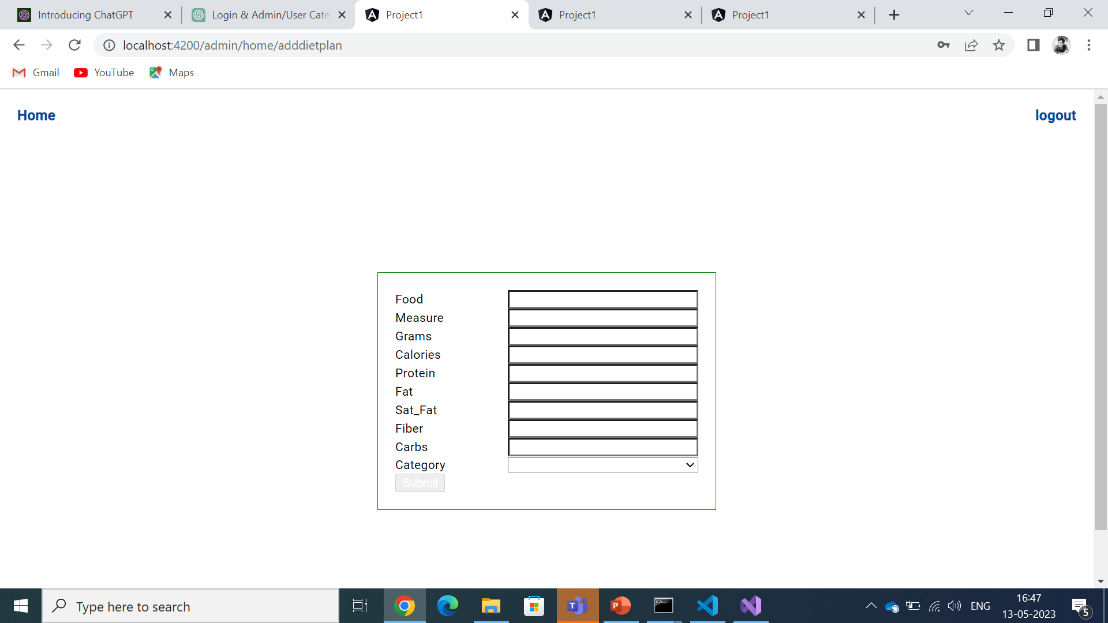
Admin add feature
An admin can add an item of his wish the list as well the list will be amended accordingly . The total list will take the addition and display it until the admin again decides to delete it as well.
The category list has a drop down box produce an error that might not add it in the needed category.

Slide 6
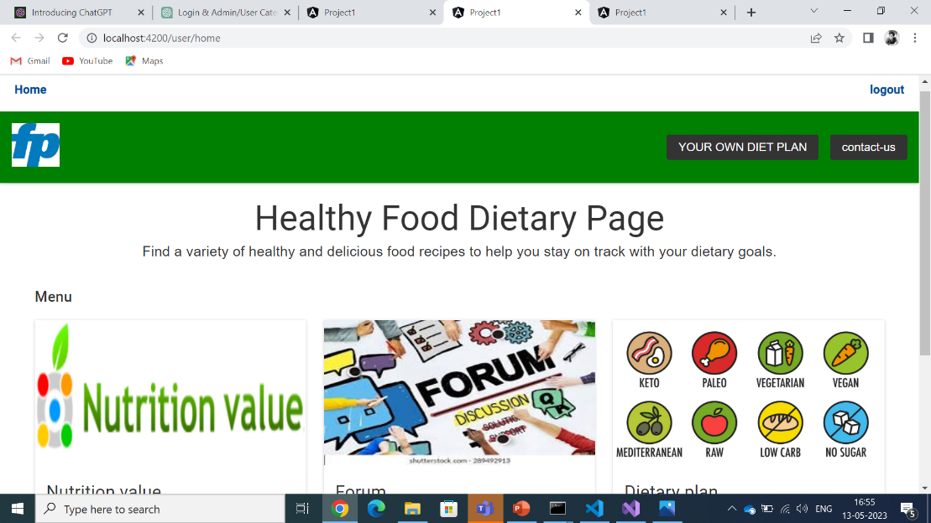
User side interface
The user has different features, the page that shows the products available its nutritional values, a forum for discussion and a page that displays multiple diet plans available and plan your own diet that calculates your whole diet calories based on the products you selected.
The user logout option and the user home button are always on display.

Slide 7
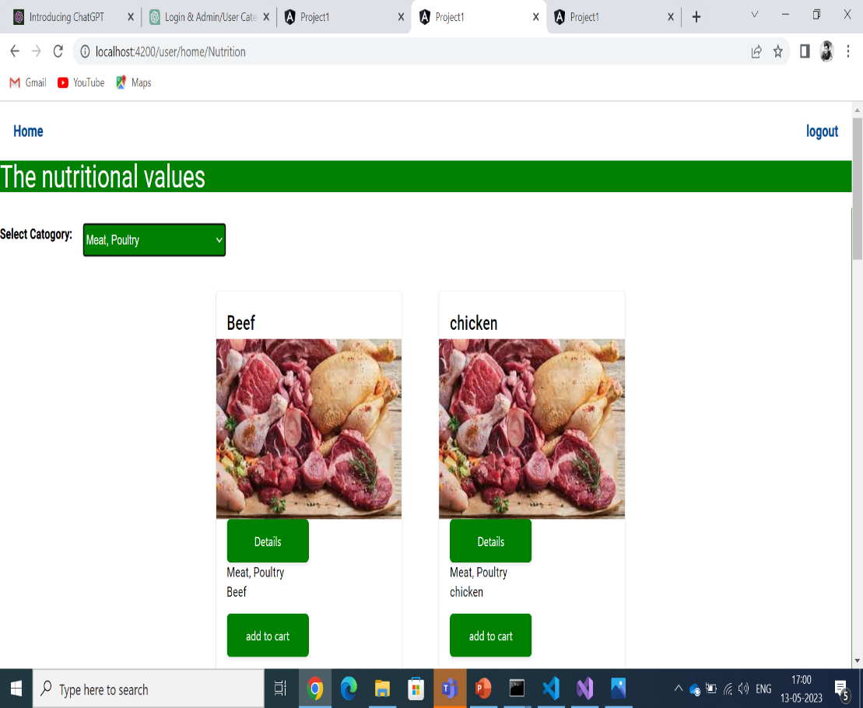
User products display
The user can see the types of foods available for the user to have and have been not deleted by the admin.
The user has a option of selecting the category of food as well to get to the product required as soon as possible.
After reaching to the selected product the user has two options the user can either click on details or add to cart option.
The product gets added to dietary plan if he adds to cart. The details of the product are displayed.

Slide 8
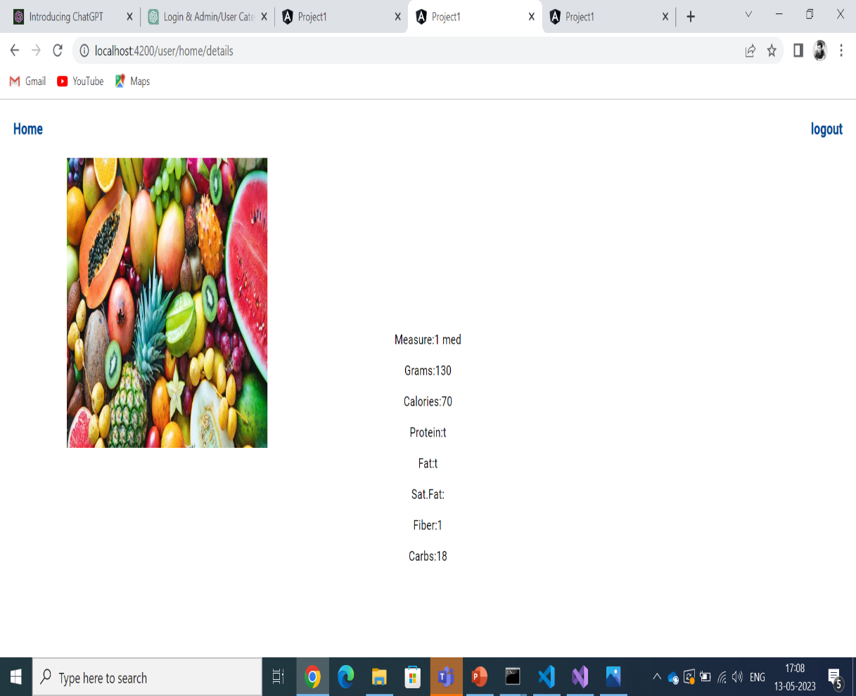
User products display
The details of each product which is the total number of calories, protein and other elements present in a particular measured amount of the element is displayed.
The user can opt to reach directly to the home from this page or even log out.

Slide 9
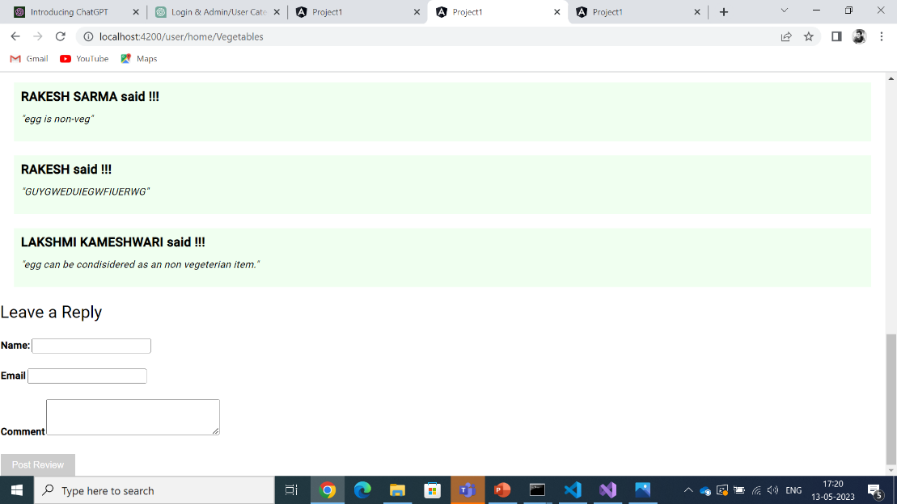
User forum discussion
A discussion forum is created where users can send their opinions and have discussion on it in a public forum.
The users can see the opinions of others as well.
The input required to take the name , email and the comments are taken in using forms module. The details are verified as well. The name needs to be minimum of 3 characters and the message entered should be at least 15 characters.

Slide 10
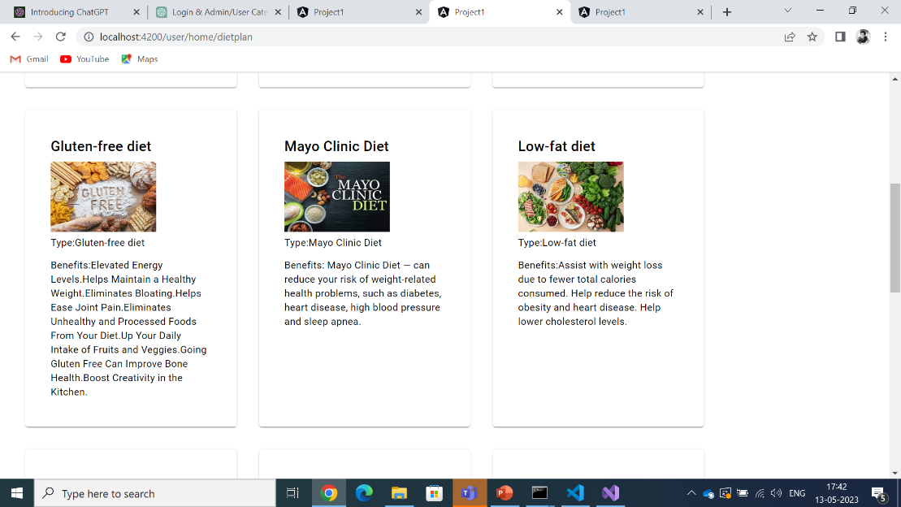
Dietary plans type
There are 9 types of diets mentioned. All the 9 types of details and their benefits are stored in the json file.
The details are displayed and the benefits of the diets are displayed.

Slide 11
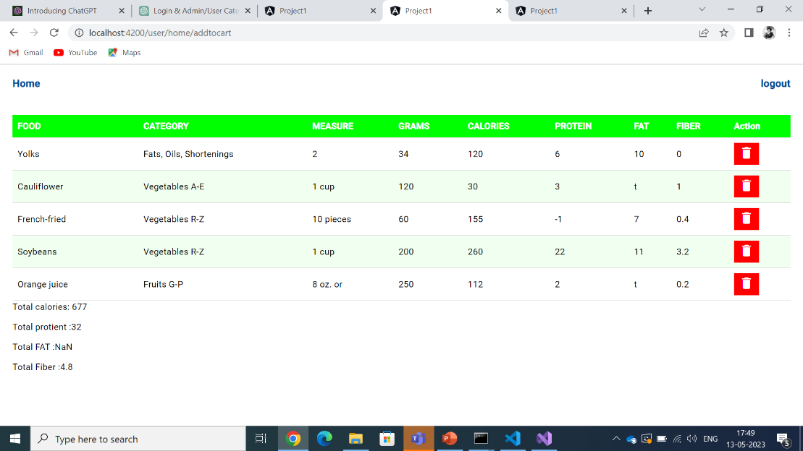
Create your own diet plan
The user can input different types of food products from different categories and sum up all to get a required amount of calories basing which he can create his own diet.
The details taken in add to cart are summed up and total number of calories in take ,proteins, etc all the details are displayed.
If the user wants to remove any element that he has added by mistake even that can be modified.

